Slide 1
Software Construction
moving from design to implementation code

Slide 2
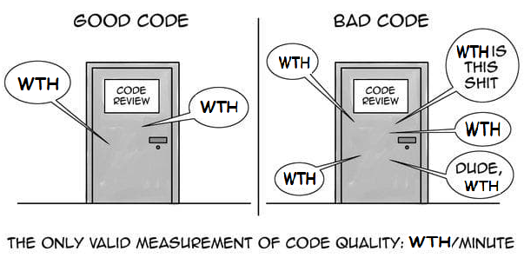
Introduction
Which door represents your code?
Which door represents your team or your company?
Why are we in that room?
Is this just a normal code review or have we found a stream of horrible problems shortly after going live?
Are we debugging in a panic, poring over code that we thought worked?
Are customers leaving in droves and managers breathing down our necks?
How can we make sure we wind up behind the right door when the going gets tough?

Slide 3
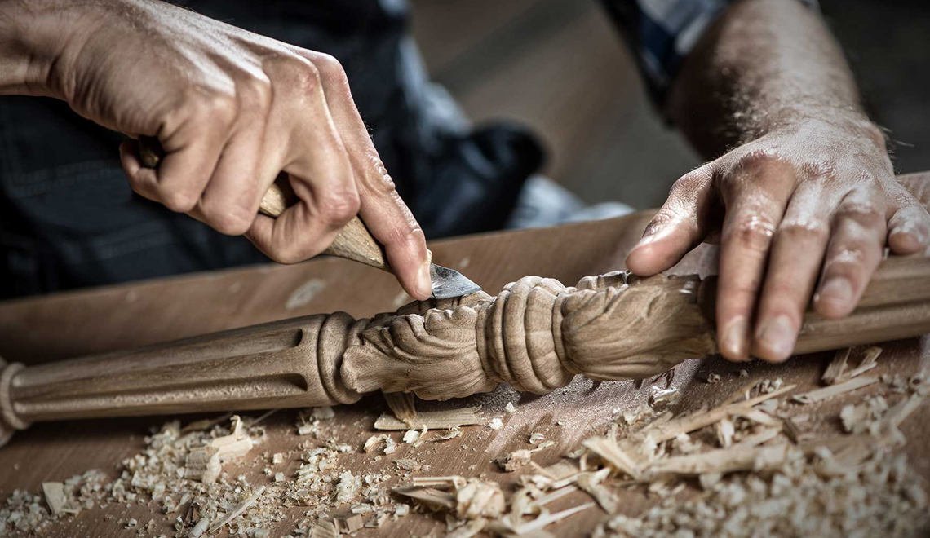
The answer is…..
Craftsmanship

Slide 4
Craftsmanship
There are two parts to learning craftsmanship:
Knowledge
Work
You must gain the knowledge of principles, patterns, practices, and heuristics that a craftsman knows.
And you must also grind that knowledge into your fingers, eyes, and gut by working hard and practicing.

Slide 5

Example
I can teach you the physics of riding a bicycle. Indeed, the classical mathematics is relatively straightforward. Gravity, friction, angular momentum, center of mass, and so forth, can be demonstrated with less than a page full of equations. Given those formulae I could prove to you that bicycle riding is practical and give you all the knowledge you needed to make it work. And you’d still fall down the first time you climbed on that bike.

Slide 6
There Will Be Code
One might argue that a book about code is somehow behind the times—that code is no longer the issue; that we should be concerned about models and requirements instead.
Indeed, some have suggested that we are close to the end of code. That soon all code will be generated instead of written. That programmers simply won’t be needed because businesspeople will generate programs from specifications.
No! We will never be rid of code, because code represents the details of the requirements. At some level, those details cannot be ignored or abstracted; they have to be specified.
And specifying requirements in such detail that a machine can execute them is programming. Such a specification is code.

Slide 7
Continue…
Level of abstraction of our languages will continue to increase
The number of domain-specific languages will continue to grow.
Indeed, all the specifications written in these higher level and domain-specific language will be code! It will still need to be rigorous, accurate, and so formal and detailed that a machine can understand and execute it.
These machines will have to be able to understand us so well that they can translate vaguely specified needs into perfectly executing programs that precisely meet those needs.
Not even single human, with all their intuition and creativity, have been able to create successful systems from the vague feelings of their customers. Indeed, if the discipline of requirements specification has taught us anything, it is that well-specified requirements are as formal as code and can act as executable tests of that code!

Slide 8
Bad Code
Kent Beck’s in his book “Implementation Patterns” he says, “. . . This book is based on a rather fragile premise: that good code matters. . . .”
A fragile premise? I disagree! I think that premise is one of the most robust, supported, and overloaded of all the premises in our craft (and I think Kent knows it). We know good code matters because we’ve had to deal for so long with it lack.
In the late 80s, one company wrote a killer app. It was very popular, and lots of professionals bought and used it. But then the release cycles began to stretch. Bugs were not repaired from one release to the next. Load times grew and crashes increased. People shut the product down in frustration and never used it again. The company went out of business a short time after that. Two decades later one of the early employees of that company shared the information that they had rushed the product to market and had made a huge mess in the code. As they added more and more features, the code got worse and worse until they simply could not manage it any longer. It was the bad code that brought the company down.

Slide 9
The Total Cost of Owning a Mess
Over the span of a year or two, teams that were moving very fast at the beginning of a project can find themselves moving at a snail’s pace.
Every change they make to the code breaks two or three other parts of the code. No change is trivial.
Over time the mess becomes so big and so deep and so tall, they can not clean it up. There is no way at all.
More staff to the project in hopes of increasing productivity is not versed in the design of the system. They don’t know the difference between a change that matches the design intent and a change that thwarts the design intent.
Furthermore, they, and everyone else on the team, are under horrific pressure to increase productivity. So, they all make more and more messes, driving the productivity ever further toward zero

Slide 10
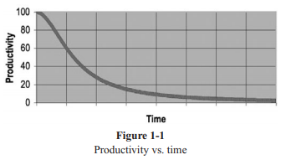
Productivity vs Time
The productivity of the team continues to decrease, asymptotically approaching zero.

Slide 11
The Grand Redesign in the Sky
Team A inform management that they cannot continue to develop in this odious code base. They demand a redesign. Management cannot deny that productivity is terrible.
A new tiger team is selected. They get to start over and create something truly beautiful. But only the best and brightest are chosen for the tiger team. Everyone else must continue to maintain the current system.
The tiger team must build a new system that does everything that the old system does, and they have to keep up with the changes that are continuously being made to the old system. Management will not replace the old system until the new system can do everything that the old system does.
This race can go on for a very long time. I’ve seen it take 10 years. And by the time it’s done, the original members of the tiger team are long gone, and the current members are demanding that the new system be redesigned because it’s such a mess. If you have experienced even one small part of the story I just told, then you already know that spending time keeping your code clean is not just cost effective; it’s a matter of professional survival.

Slide 12
The Art of Clean Code?
Writing clean code is a lot like painting a picture. Most of us know when a picture is painted well or badly.
But being able to recognize good art from bad does not mean that we know how to paint.
So too being able to recognize clean code from dirty code does not mean that we know how to write clean code!
A programmer without “code-sense” can look at a messy module and recognize the mess but will have no idea what to do about it. A programmer with “code-sense” will look at a messy module and see options and variations. The “code-sense” will help that programmer choose the best variation and guide him or her to plot a sequence of behavior preserving transformations to get from here to there. In short, a programmer who writes clean code is an artist who can take a blank screen through a series of transformations until it is an elegantly coded system.

Slide 13
What Is Clean Code?
Bjarne Stroustrup, inventor of C++ and author of The C++ Programming Language says,
“I like my code to be elegant and efficient. The logic should be straightforward to make it hard for bugs to hide, the dependencies minimal to ease maintenance, error handling complete according to an articulated strategy, and performance close to optimal so as not to tempt people to make the code messy with unprincipled optimizations. Clean code does one thing well.”

Slide 14
Continue…
Grady Booch, author of Object Oriented Analysis and Design with Applications says,
“Clean code is simple and direct. Clean code reads like well-written prose. Clean code never obscures the designer’s intent but rather is full of crisp abstractions and straightforward lines of control.”

Slide 15
Continue…
“Big” Dave Thomas, founder of OTI, godfather of the Eclipse strategy says,
“Clean code can be read and enhanced by a developer other than its original author. It has unit and acceptance tests. It has meaningful names. It provides one way rather than many ways for doing one thing. It has minimal dependencies, which are explicitly defined, and provides a clear and minimal API. Code should be literate since depending on the language, not all necessary information can be expressed clearly in code alone.”

Slide 16
Continue…
Michael Feathers, author of Working Effectively with Legacy Code says,
“I could list all of the qualities that I notice in clean code, but there is one overarching quality that leads to all of them. Clean code always looks like it was written by someone who cares. There is nothing obvious that you can do to make it better. All of those things were thought about by the code’s author, and if you try to imagine improvements, you’re led back to where you are, sitting in appreciation of the code someone left for you—code left by someone who cares deeply about the craft.”

Slide 17
Continue…
Ward Cunningham, inventor of Wiki, inventor of Fit, coinventor of eXtreme Programming. Motive force behind Design Patterns. Smalltalk and OO thought leader. The godfather of all those who care about code.
“You know you are working on clean code when each routine you read turns out to be pretty much what you expected. You can call it beautiful code when the code also makes it look like the language was made for the problem.”

Slide 18
The Boy Scout Rule
The Boy Scouts of America have a simple rule that we can apply to our profession.
“Leave the campground cleaner than you found it.”
If we all checked-in our code a little cleaner than when we checked it out, the code simply could not rot. The cleanup doesn’t have to be something big. Change one variable name for the better, break up one function that’s a little too large, eliminate one small bit of duplication, clean up one composite if statement.

